Slide 1

Natural Language Processing
Yue Zhang
Westlake University

Slide 2
Week 2
Model and Data

Slide 3
Overview
Week 2
Overview of NLP architecture
Data and Model
Review of background
Linear Models
Week 3
Week 4
Week 5
Week 6
Week 7
N-gram Language Models
Naïve Bayes
Generative Text Classification
Features
Document Representation
Discriminative Text Classification
Neuron
SGD
Entropy, Perplexity
Word Representation
HMM -- Generative Sturctured Prediction
CRF – Discriminative Structured Prediction
Neural Models
Week 8
Week 10
Week 12
MLP, Multi-Layer Perception
Neural N-gram LM and Word Embedding
Neural Structured Prediction
Sequence-to-sequence
Neural Recurrent Language Models
Week 9
Week 13
Sequence Representation
Neural Text Classification
Week 11
Sequence-level Pre-training
Pre-trained Models for Text Classification and other NLP tasks
Structured Representation
Large Language Models
Week 14
Week 15
Scaling, instruction following and LLMs
LLMs for NLP, AGI and beyond

Slide 4
Overview
Week 2
Overview of NLP architecture
Data and Model
Review of background
Linear Models
Week 3
Week 4
Week 5
Week 6
Week 7
N-gram Language Models
Naïve Bayes
Generative Text Classification
Features
Document Representation
Discriminative Text Classification
Neuron
SGD
Entropy, Perplexity
Word Representation
HMM -- Generative Sturctured Prediction
CRF – Discriminative Structured Prediction
Neural Models
Week 8
Week 10
Week 12
MLP, Multi-Layer Perception
Neural N-gram LM and Word Embedding
Neural Structured Prediction
Sequence-to-sequence
Neural Recurrent Language Models
Week 9
Week 13
Sequence Representation
Neural Text Classification
Week 11
Sequence-level Pre-training
Pre-trained Models for Text Classification and other NLP tasks
Structured Representation
Large Language Models
Week 14
Week 15
Scaling, instruction following and LLMs
LLMs for NLP, AGI and beyond

Slide 5
Goal of this lecture
overview of modeling paradigm
lay common background for subsequent work
introduction to data curation
review of probability concepts

Slide 6
Outline
2.1 The modeling paradigm
2.1.1 Categorizing NLP tasks
2.1.2 The modeling paradigm
2.1.3 Training
2.1.4 Evaluation
2.2 Data
2.2.1 The Framework
2.2.2 Data Collection
2.2.3 Annotation
2.2.4 Quality Control
2.3 Probability
2.3.1 Probability distribution
2.3.2 Multiple random variables

Slide 7
Outline
2.1 The modeling paradigm
2.1.1 Categorizing NLP tasks
2.1.2 The modeling paradigm
2.1.3 Training
2.1.4 Evaluation
2.2 Data
2.2.1 The Framework
2.2.2 Data Collection
2.2.3 Annotation
2.2.4 Quality Control
2.3 Probability
2.3.1 Probability distribution
2.3.2 Multiple random variables

Slide 8
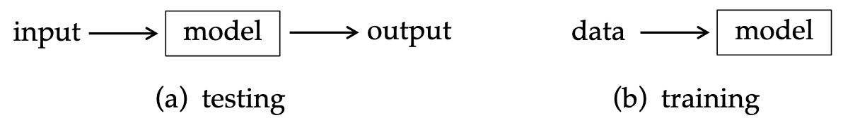
Model and Data

Slide 9
Outline
2.1 The modeling paradigm
2.1.1 Categorizing NLP tasks
2.1.2 The modeling paradigm
2.1.3 Training
2.1.4 Evaluation
2.2 Data
2.2.1 The Framework
2.2.2 Data Collection
2.2.3 Annotation
2.2.4 Quality Control
2.3 Probability
2.3.1 Probability distribution
2.3.2 Multiple random variables

Slide 10
Task Categories
Classification
Structured Prediction
Generation
Category | Task | Input | Output
Text classification | Sentiment Classification | “The movie was fantastic! I loved evey minute of it.” | Positive
 | Natural Language Inference | Premise: “A man is playing a guitar.” Hypothesis: “A man is playing music.” | Entailment

Slide 11
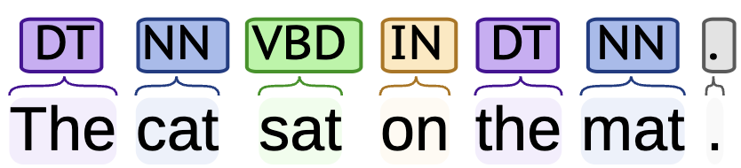
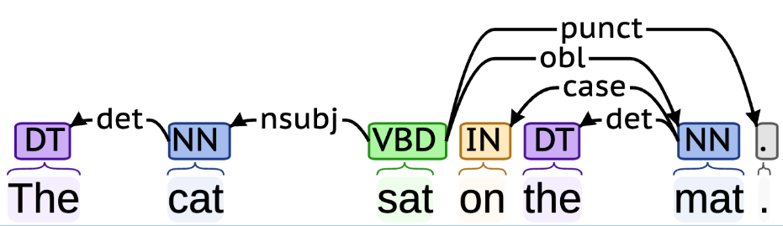
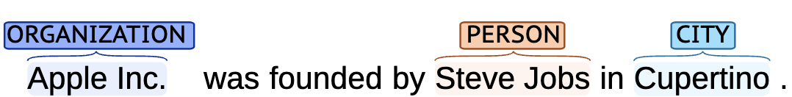
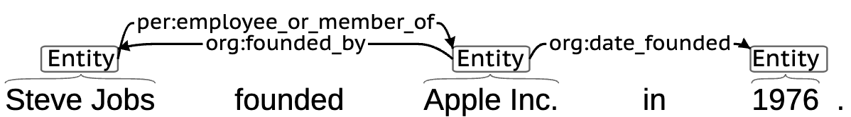
Task Categories
Category | Task | Input | Output
Structured Prediction | POS-tagging | “The cat sat on the mat.”
 | Dependecy Parsing | “The cat sat on the mat.”
 | Named Entity Recognition | “Apple Inc. was founded by Steve Jobs in Cupertino.”
 | Relation Extraction | ”Steve Jobs founded Apple Inc. in 1976.”

Slide 12

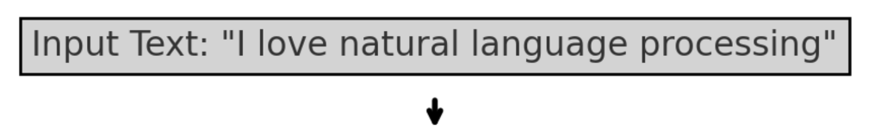
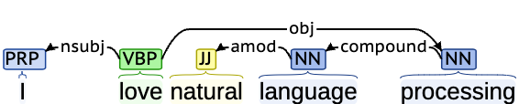
Joint Structed Prediction Tasks
joint word segmentation and POS-tagging
Input Text: “我爱自然语言处理”
Word Segmentation: [“我”, “爱”, “自然”, “语言”, “处理”]
POS Tagging: [“我/PRON”, “爱/VB”, “自然/JJ”, “语言/NN”, “处理/NN”
joint POS-tagging and dependency parsing
Dependency Parsing

Slide 13
Task Categories
Category | Task | Input | Output
Generation | Text Summarisation | “The Eiffel Tower, located in Paris, France, is one of the most iconic landmarks in the world. It was completed in 1889 and attracts millions of visitors annually.” | “The Eiffel Tower is a famous landmark in Paris, completed in 1889.”
 | Machin Translation | “Hello, how are you?” | “Bonjour, comment ça va ?”
 | Code Generation | “Write a Python function to add two numbers.” | def add(a,b): return a + b

Slide 14
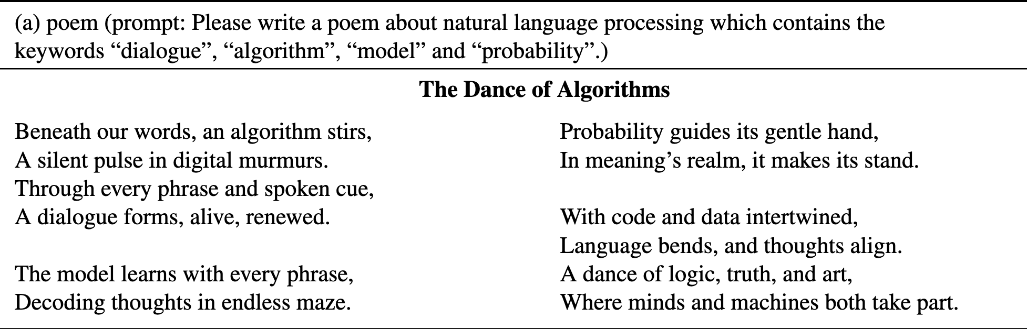
Generic Model
Treats all tasks as generation.

Slide 15
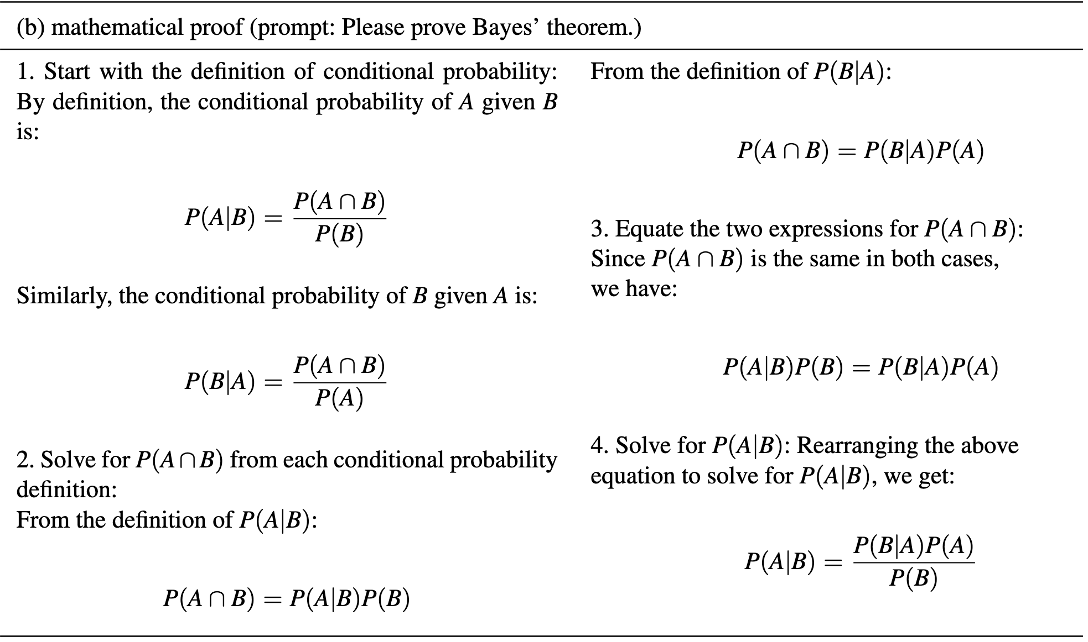
Generic Model
Treats all tasks as generation.

Slide 16
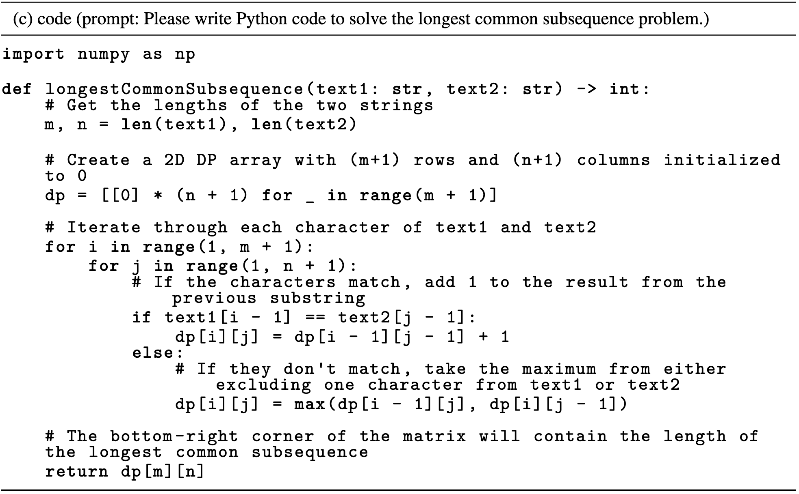
Generic Model
Treats all tasks as generation.

Slide 17
Task Categories
Categories
Classification
Structed Prediction
Generation
All tasks have discrete (categorial) elements.
e.g., class label, dependency arc, token.

Slide 18
Outline
2.1 The modeling paradigm
2.1.1 Categorizing NLP tasks
2.1.2 The modeling paradigm
2.1.3 Training
2.1.4 Evaluation
2.2 Data
2.2.1 The Framework
2.2.2 Data Collection
2.2.3 Annotation
2.2.4 Quality Control
2.3 Probability
2.3.1 Probability distribution
2.3.2 Multiple random variables

Slide 19
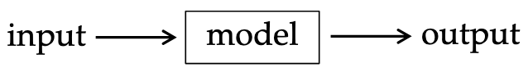
The modeling paradigm
How does a model transform an input $x$ to an output $y$?
3 + 5 =？

Slide 20
The modeling paradigm
How does a model transform an input $x$ to an output $y$?
model parameters
(suitable for discrete outputs.)

Slide 21
The modeling paradigm
How does a model transform an input $x$ to an output $y$?
model parameters
probabilistic models
For structured prediction and generation, the modeling target can be a sub task.
e.g., I ate pizza with a ______.

Slide 22
The modeling paradigm
parameterization
- linear model
representation vector
- neural model
the representation and the scoring function (parameterization) are key elements in modeling.

Slide 23
Searching for the output
For classification, brute force enumeration.
For structured tasks, the search algorithm can be non-trivial.

Slide 24
Outline
2.1 The modeling paradigm
2.1.1 Categorizing NLP tasks
2.1.2 The modeling paradigm
2.1.3 Training
2.1.4 Evaluation
2.2 Data
2.2.1 The Framework
2.2.2 Data Collection
2.2.3 Annotation
2.2.4 Quality Control
2.3 Probability
2.3.1 Probability distribution
2.3.2 Multiple random variables

Slide 25
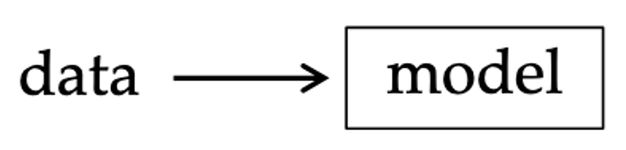
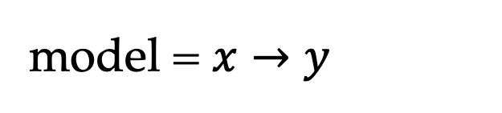
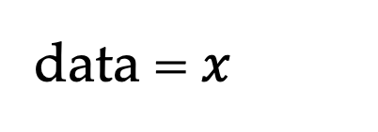
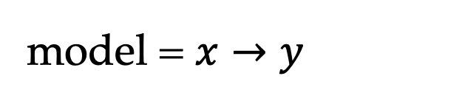
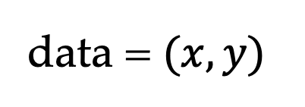
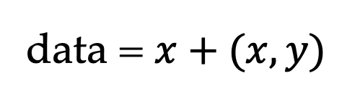
Training
Supervised learning
data = $(x,y)$
model = $x→y$
Unsupervised learning
data = $x$
model = $x→y$
Semi-supervised learning
data = $x+(x,y)$
model = $x→y$

Slide 26
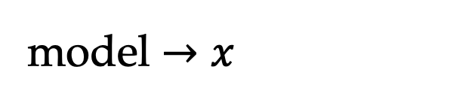
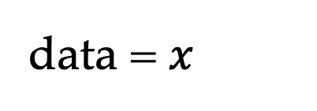
Training
Supervised learning
data = $(x,y)$
model = $x→y$
Unsupervised learning
data = $x$
model = $x→y$
Semi-supervised learning
data = $x+(x,y)$
model = $x→y$
Self-supervised learning (pre-training)
data = $x$
model $→x$
e.g., next token prediction

Slide 27
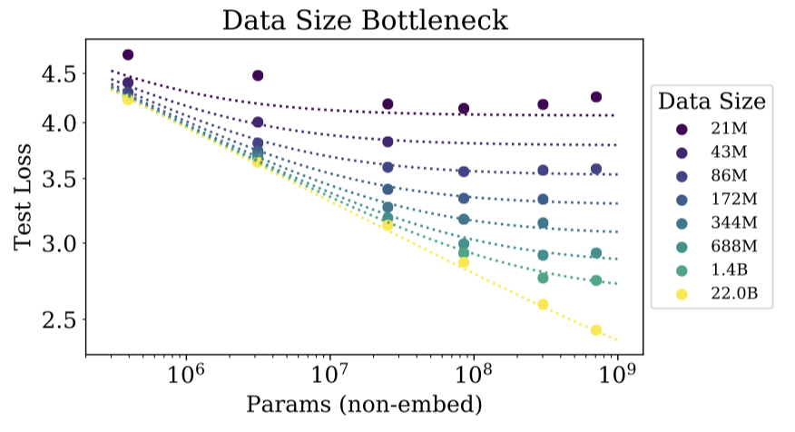
Training
The effect of training data size
The scaling law
useful for saving development time and cost
not restricted to data size

Slide 28
Outline
2.1 The modeling paradigm
2.1.1 Categorizing NLP tasks
2.1.2 The modeling paradigm
2.1.3 Training
2.1.4 Evaluation
2.2 Data
2.2.1 The Framework
2.2.2 Data Collection
2.2.3 Annotation
2.2.4 Quality Control
2.3 Probability
2.3.1 Probability distribution
2.3.2 Multiple random variables

Slide 29
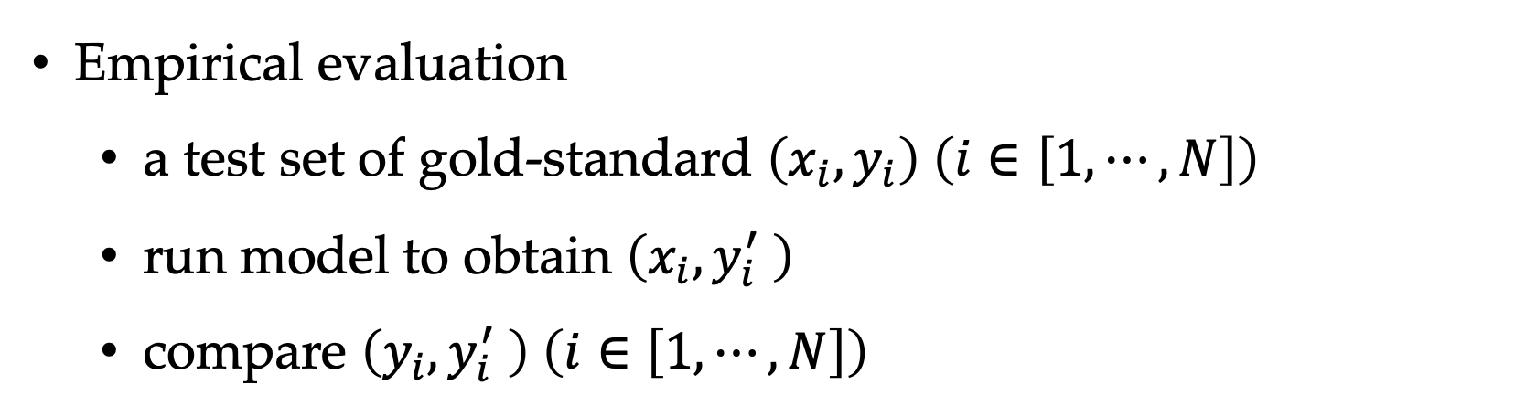
Evaluation
Empirical evaluation
a test set of gold-standard $\left(x_{i},y_{i}\right) \left(i∈\left[1,⋯,N\right]\right)$
run model to obtain $\left(x_{i},y_{i}^{′} \right)$
compare $\left(y_{i},y_{i}^{′} \right) \left(i∈\left[1,⋯,N\right]\right)$
The test data size influences the reliability.

Slide 30
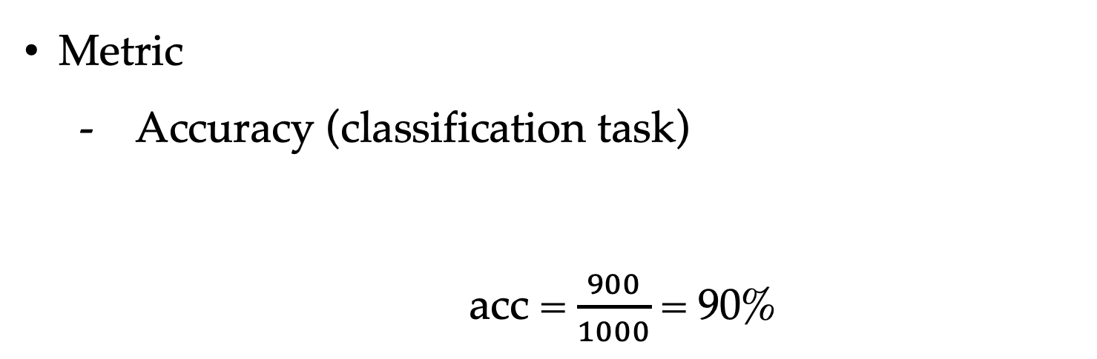
Evaluation
Metric
Accuracy (classification task)
acc = $\frac{900}{1000}$ = 90%
1000 samples, 900 correct

Slide 31
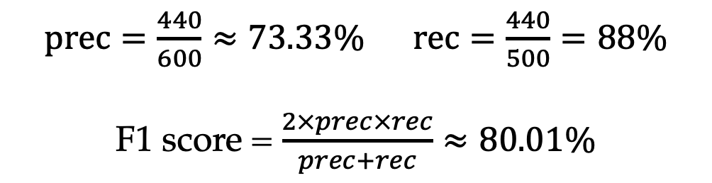
Evaluation
Metric
Accuracy
Precision, recall and F-measure (classification task)
data
model
Sentiment classification (positive, negative, neutral)
1000 samples, 500 positive
model outputs 600 positive, 440 correct
60
440
160
$prec=\frac{440}{600}≈73.33\%$ $rec=\frac{440}{500}=88\%$
F1 score = $\frac{2×prec×rec}{prec+rec}≈80.01\%$

Slide 32
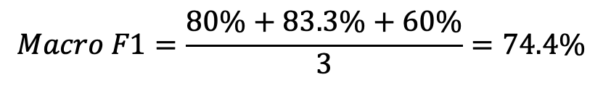
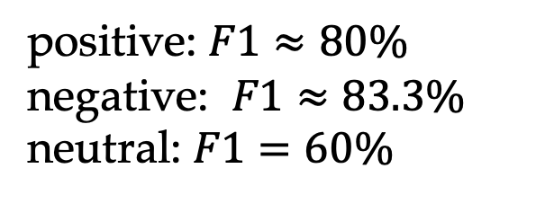
Evaluation
Metric
Accuracy
Precision, recall and F-measure
Macro F1 (classification task)
Sentiment classification (positive, negative, neutral)
1000 samples, 500 positive, 300 negative, 200 neutral
model outputs 600 positive, 440 correct;
300 negative, 250 correct; 100 neutral, 90 correct
positive: $F1≈80\%$
negative: $F1≈83.3\%$
neutral: $F1=60\%$
$$Macro F1=\frac{80\%+83.3\%+60\%}{3}=74.4\%$$

Slide 33
Evaluation
Metric
Accuracy
Precision, recall and F-measure
Macro F1
More metrics for structured prediction and generation
tasks later.

Slide 34
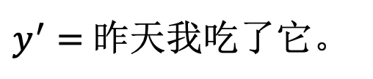
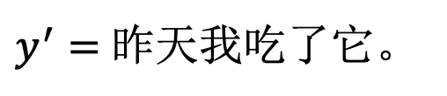
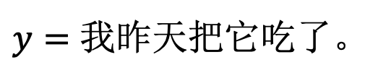
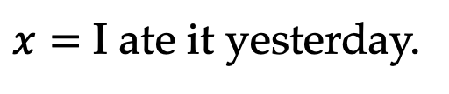
Evaluation
Model–based Evaluation
Reference–based evaluation
$x=$ I ate it yesterday.
$y=$ 我昨天把它吃了。
$y^{′}=$ 昨天我吃了它。
adequacy = ? fluency = ?
Reference–free evaluation
$x=$ I ate it yesterday.
$y^{′}=$ 昨天我吃了它。
Meta evaluation — evaluating the evaluator.

Slide 35
Significance Test
Results on one test set may not reflect robustness to unseen data.
model A - 93% model B – 95%
How can I interpret the difference?
- the null hypothesis
Significance
probability of null hypothesis
p-level 0.05/0.01/0.001

Slide 36
Development Test
The need to repeatedly test model performance during development.
Optimization over test data does not reflect performance on unseen data.
Leave the test set held-out for simulating unseen test set.
Use a different validation set for model development.
training
dev
test

Slide 37

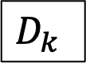
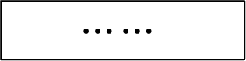
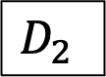
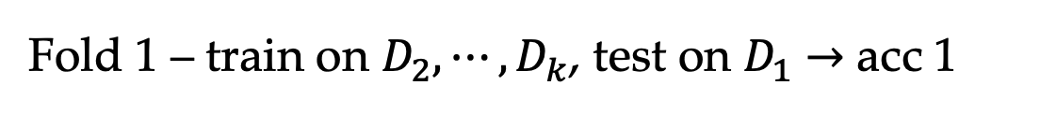
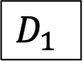
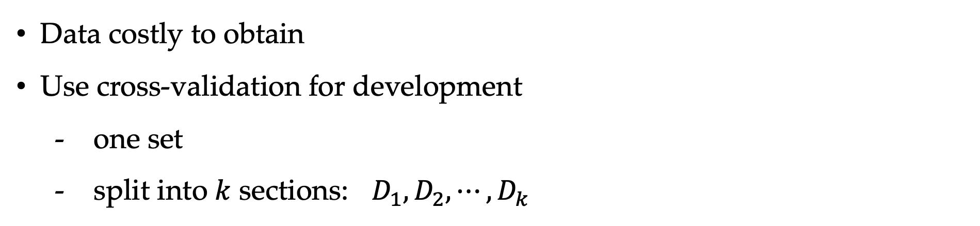
Cross Validation
training
dev
test
Data costly to obtain
Use cross-validation for development
one set
split into $k$ sections: $D_{1},D_{2},⋯,D_{k}$
V.S.
$$D_{1}$$
$$D_{2}$$
$$⋯⋯$$
$$D_{k}$$
Fold 1 – train on $D_{2},⋯,D_{k}$, test on $D_{1}$ $→$ acc 1
Fold 2 – train on $D_{1},D_{3}⋯,D_{k}$, test on $D_{2}$ $→$ acc 2
$$⋮$$
Fold $i$ – train on the rest, test on $D_{i}$ $→$ acc $i$
result = avg(acc 1, acc 2, $⋯$ acc $k$)

Slide 38
Outline
2.1 The modeling paradigm
2.1.1 Categorizing NLP tasks
2.1.2 The modeling paradigm
2.1.3 Training
2.1.4 Evaluation
2.2 Data
2.2.1 The Framework
2.2.2 Data Collection
2.2.3 Annotation
2.2.4 Quality Control
2.3 Probability
2.3.1 Probability distribution
2.3.2 Multiple random variables

Slide 39
Data is key to NLP
- for model training and evaluation.

Slide 40
Outline
2.1 The modeling paradigm
2.1.1 Categorizing NLP tasks
2.1.2 The modeling paradigm
2.1.3 Training
2.1.4 Evaluation
2.2 Data
2.2.1 The Framework
2.2.2 Data Collection
2.2.3 Annotation
2.2.4 Quality Control
2.3 Probability
2.3.1 Probability distribution
2.3.2 Multiple random variables

Slide 41
Framework
data collection
data preparation
(annotation, filtering, …)
quality estimation

Slide 42
Outline
2.1 The modeling paradigm
2.1.1 Categorizing NLP tasks
2.1.2 The modeling paradigm
2.1.3 Training
2.1.4 Evaluation
2.2 Data
2.2.1 The Framework
2.2.2 Data Collection
2.2.3 Annotation
2.2.4 Quality Control
2.3 Probability
2.3.1 Probability distribution
2.3.2 Multiple random variables

Slide 43
Data Collection
Data Domain
news, social media, bio, code, …
multi-domain
Data Sources
Publicly available data
raw text corpora
labeled data
gold manual labels, silver labels
data quality is not perfect (see later) e.g.,
for POS-tagging, the human-level agreement is about 97.2%¹.
1. Fort K, Sagot B. Influence of pre-annotation on POS-tagged corpus development[C]//The fourth ACL linguistic annotation workshop. 2010: 56-63.

Slide 44
Data Collection
Data Domain
news, social media, bio, code, …
multi-domain
Data Sources
Publicly available data
web crawling
crawler
filtering
pre-processing (e.g., normalize, URL, numbers, capitalization)
License !

Slide 45
Data Collection
Brown Corpus
Overview:
Compiled in 1961 at Brown University by Kucera & Francis.
First electronic corpus of American English (~1 million words).
Data Collection:
500 text samples (2,000 words each) from 1961 publications.
Covers 15 genres (news, fiction, academic, etc.) for diversity.
Data Processing:
Manually transcribed into machine-readable form.
Standardized formatting & part-of-speech tagging.
Proofread and error-checked for accuracy.

Slide 46
Data Collection
Books Corpus
Created by researchers at Google AI in 2015. Contains over 800 million words from 11,038 books. Widely used for pre-training language models like BERT.
Data Collection:
Sourced from free, unpublished books available online.
Focused on long-form, diverse narratives across multiple genres (fiction, history, etc.).
Data Processing:
Cleaned to remove duplicates, formatting errors, and irrelevant content.
Tokenized and standardized for natural language processing tasks.
Balanced to provide a rich and varied language dataset.

Slide 47
Data Collection
RedPajama-Data-v2
Released in 2023 by Together AI. Comprises over 100 billion text documents, totaling 30 trillion tokens after deduplication. Covers five languages: English, French, Spanish, German, and Italian.
Data Collection:
Sourced from 84 CommonCrawl snapshots.
Processed using the CCNet pipeline to extract clean text.
Data Processing:
Quality Annotations: Computed over 40 quality signals (e.g., perplexity scores, language identification) to assist in data filtering and weighting.
Deduplication: Applied techniques like Bloom filters and minhashing to identify and remove duplicate content, ensuring a unique dataset.

Slide 48
Outline
2.1 The modeling paradigm
2.1.1 Categorizing NLP tasks
2.1.2 The modeling paradigm
2.1.3 Training
2.1.4 Evaluation
2.2 Data
2.2.1 The Framework
2.2.2 Data Collection
2.2.3 Annotation
2.2.4 Quality Control
2.3 Probability
2.3.1 Probability distribution
2.3.2 Multiple random variables

Slide 49
The Annotation Process
Make annotation guidelines.
Develop annotation tools
interface —— IDE for labeling and collaboration
data format —— typically according to annotation schema
data storage
Pre-annotation —— adjust guidelines
Formal annotation
multiple labelers —— linguists, professors, authors, students
verifier —— experienced labeler
Model training and testing —— may adjust guidelines accordingly.

Slide 50
Annotation Guideline
The goal of annotations
The annotation schema
what are the labels
where to label
examples
ambiguous cases
How to make annotation
process
tools

Slide 51
Annotation Schema —— Example
Goal: label for news classification
Label set:
political news —— P
technological news —— T
financial news —— F
sports news —— S
Format:
<label>
<document>
Example:
P
In a significant political development, Dallas Mayor Eric Johnson has switched from the Democratic to the Republican Party after over a decade in office. He believes this transition signifies a broader cultural shift in the U.S., influenced by President-elect Donald Trump. Johnson highlighted Trump's appeal to minority groups, especially Hispanics, contributing to the GOP's gains in the 2024 election. His change makes Dallas the largest U.S. city led by a Republican mayor.

Slide 52
Example: Movie Reviews Sentiment Analysis
Goal:
Each review is labeled as positive or negative sentiment.
Label Set:
Some datasets include a neutral category or fine-grained ratings (e.g., 1-5 stars).

Slide 53
Example: Movie Reviews Sentiment Analysis
Examples (IMDB Dataset):
review: "This movie was absolutely fantastic! The storytelling was engaging, and the performances were top-notch. The lead actor delivered an emotionally powerful performance that kept me hooked from start to finish. The cinematography was breathtaking, with stunning visuals that perfectly complemented the mood of the film. The soundtrack was also a highlight, adding depth and emotion to key scenes. I highly recommend this film to anyone looking for a well-crafted, deeply moving cinematic experience. Definitely one of the best movies I've seen in a long time! "
sentiment: Positive
Evaluation Metrics:
Accuracy, F1-score

Slide 54
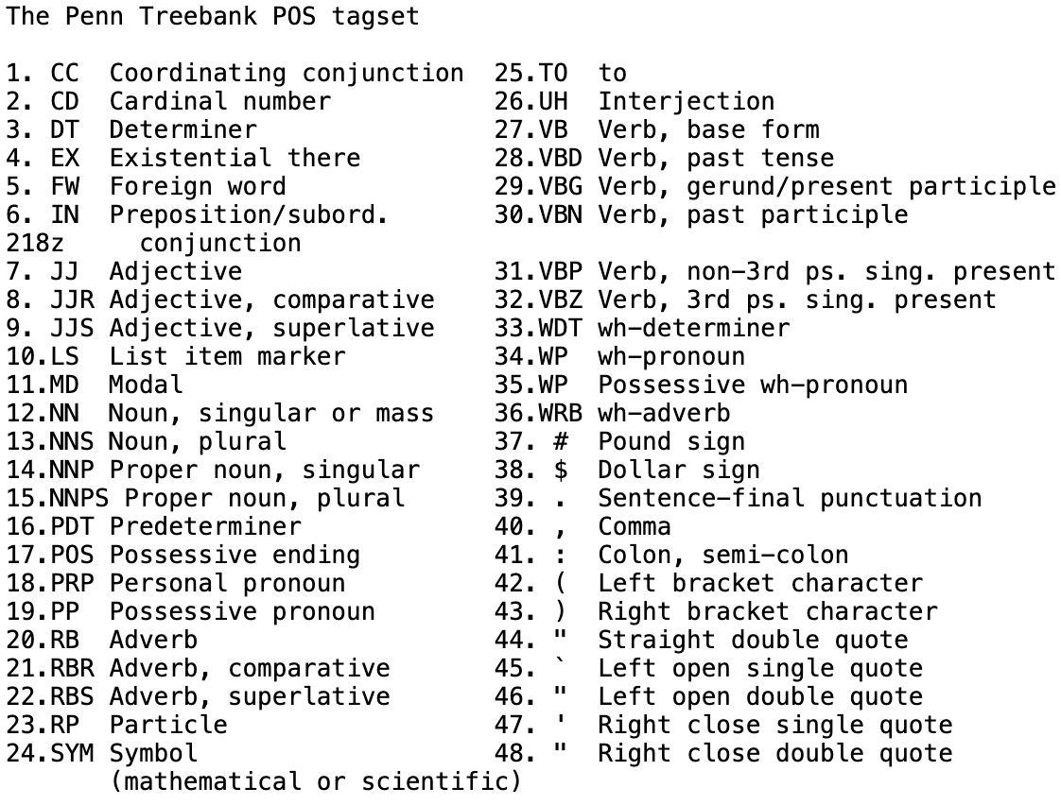
Example: Penn Treebank (PTB)
Goal:
Sentences are annotated with constituency parse trees, defining the phrase structure.
Label Set:
POS tagging is included: NN (noun), VB (verb), DT (determiner), etc.
Annotation Guidelines:
grammar rules: S → NP VP, VP → V NP
-5 → -5/CD
www.example.com → www.example.com/NN

Slide 55
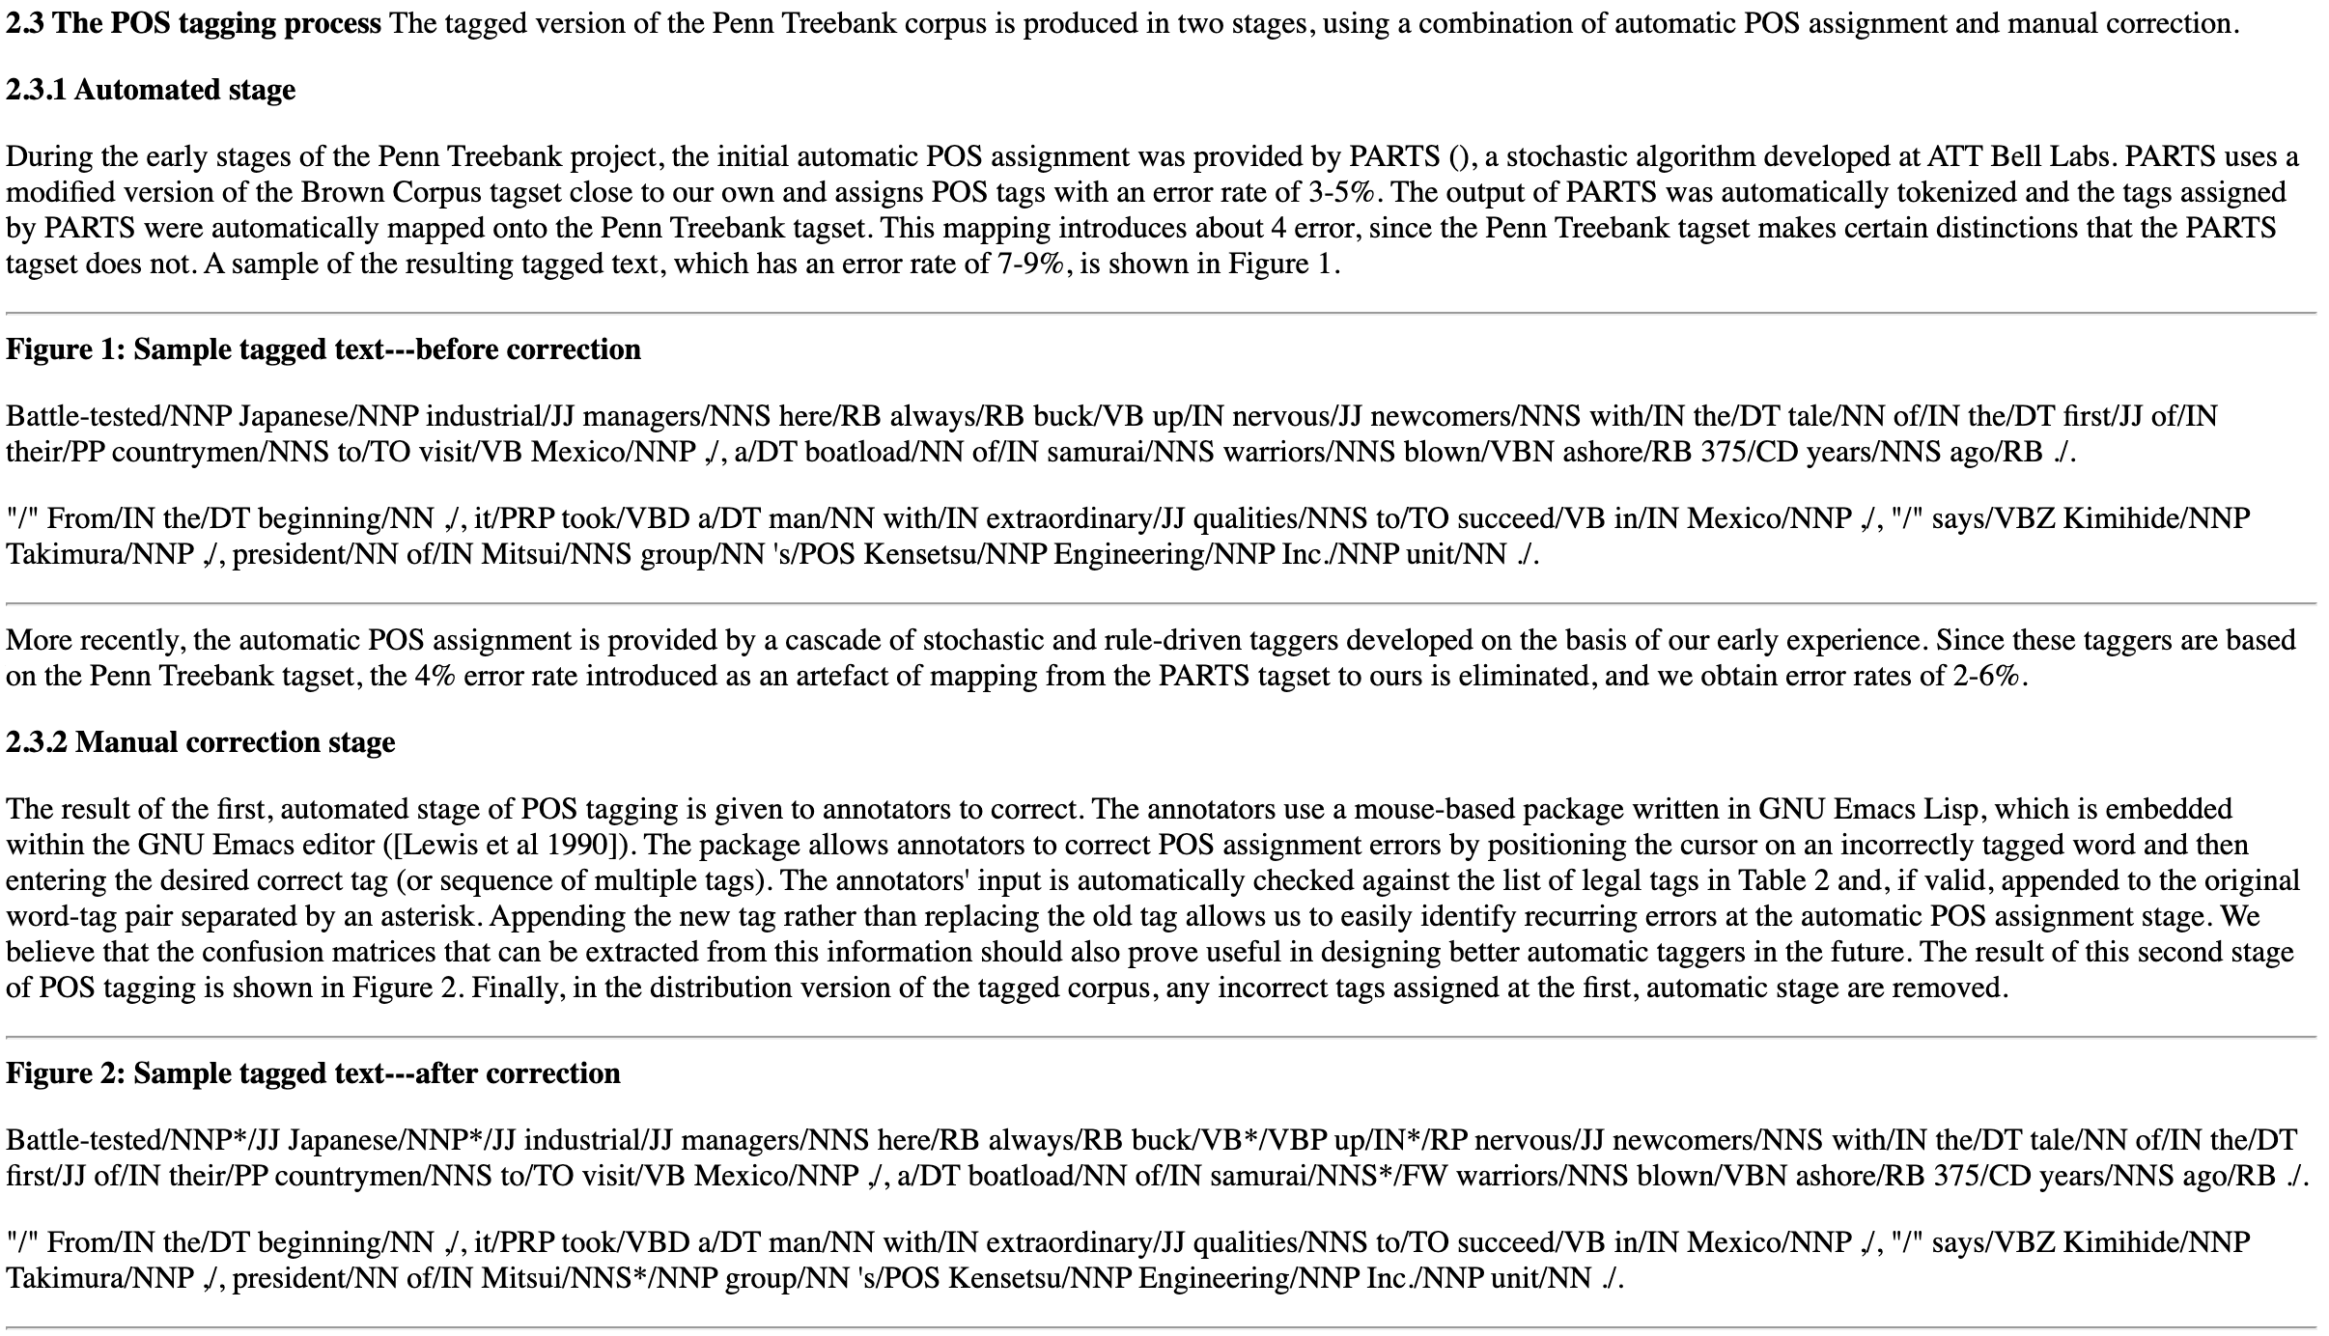
Example: Penn Treebank (PTB)
Penn Treebank Standard

Slide 56
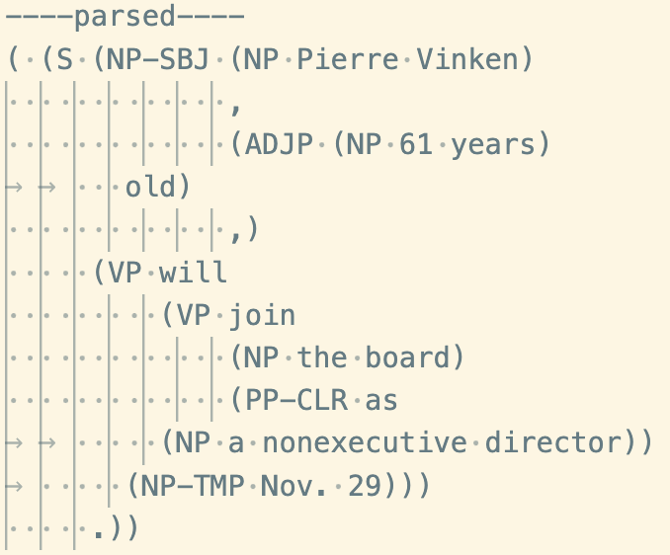
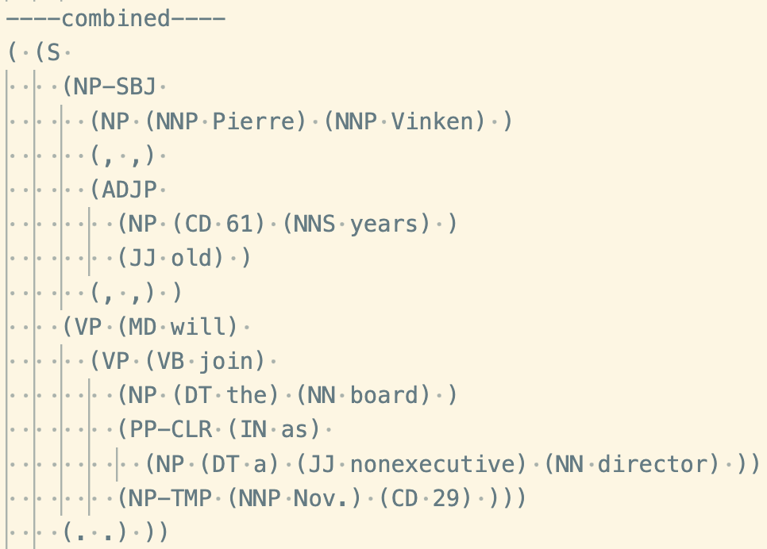
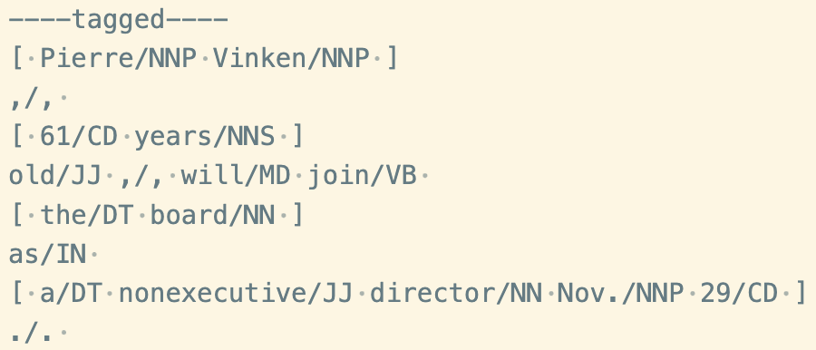
Example: Penn Treebank (PTB)
Examples:
Sentence: " Pierre Vinken, 61 years old, will join the board as a nonexecutive director Nov. 29.”
Evaluation Metrics:
Bracket, F1-score
Labeled spans (NP, 1, 1), (VP, 2, 3)
Unlabeled spans (1,1), (2,3)

Slide 57
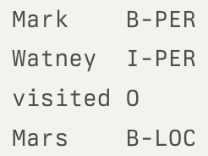
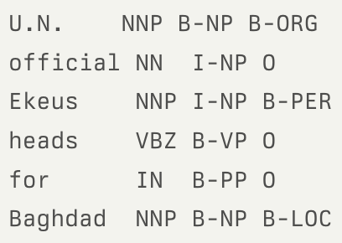
CoNLL Named Entity Recognition (NER)
Annotation Guidelines:
Identifies named entities (PER = person, ORG = organization, LOC = location, MISC = miscellaneous).
Example tag formats: BIO (Begin-Inside-Outside)
Examples:
Sentence: ” U.N. official Ekeus heads for Baghdad.”
Annotation (right image)
Evaluation Metrics:
Precision, Recall, F1-score

Slide 58
Example: Universal Dependencies
Goal:
Annotates morphology, syntax, and dependencies in a unified framework.
Label Set:
Defines grammatical relations: nsubj (nominal subject), obj (object), advmod (adverb modifier).

Slide 59
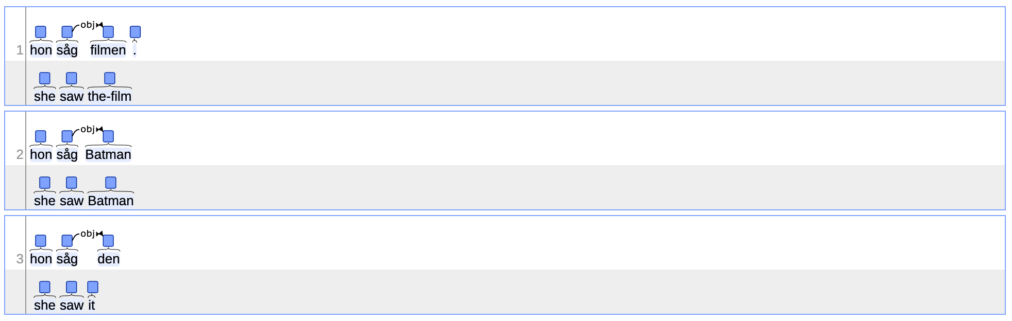
Example: Universal Dependencies
Universal Dependencies Annotation Guidelines for Nominals
A nominal minimally consists of a noun, proper noun or pronoun.
https://universaldependencies.org/#language-u

Slide 60
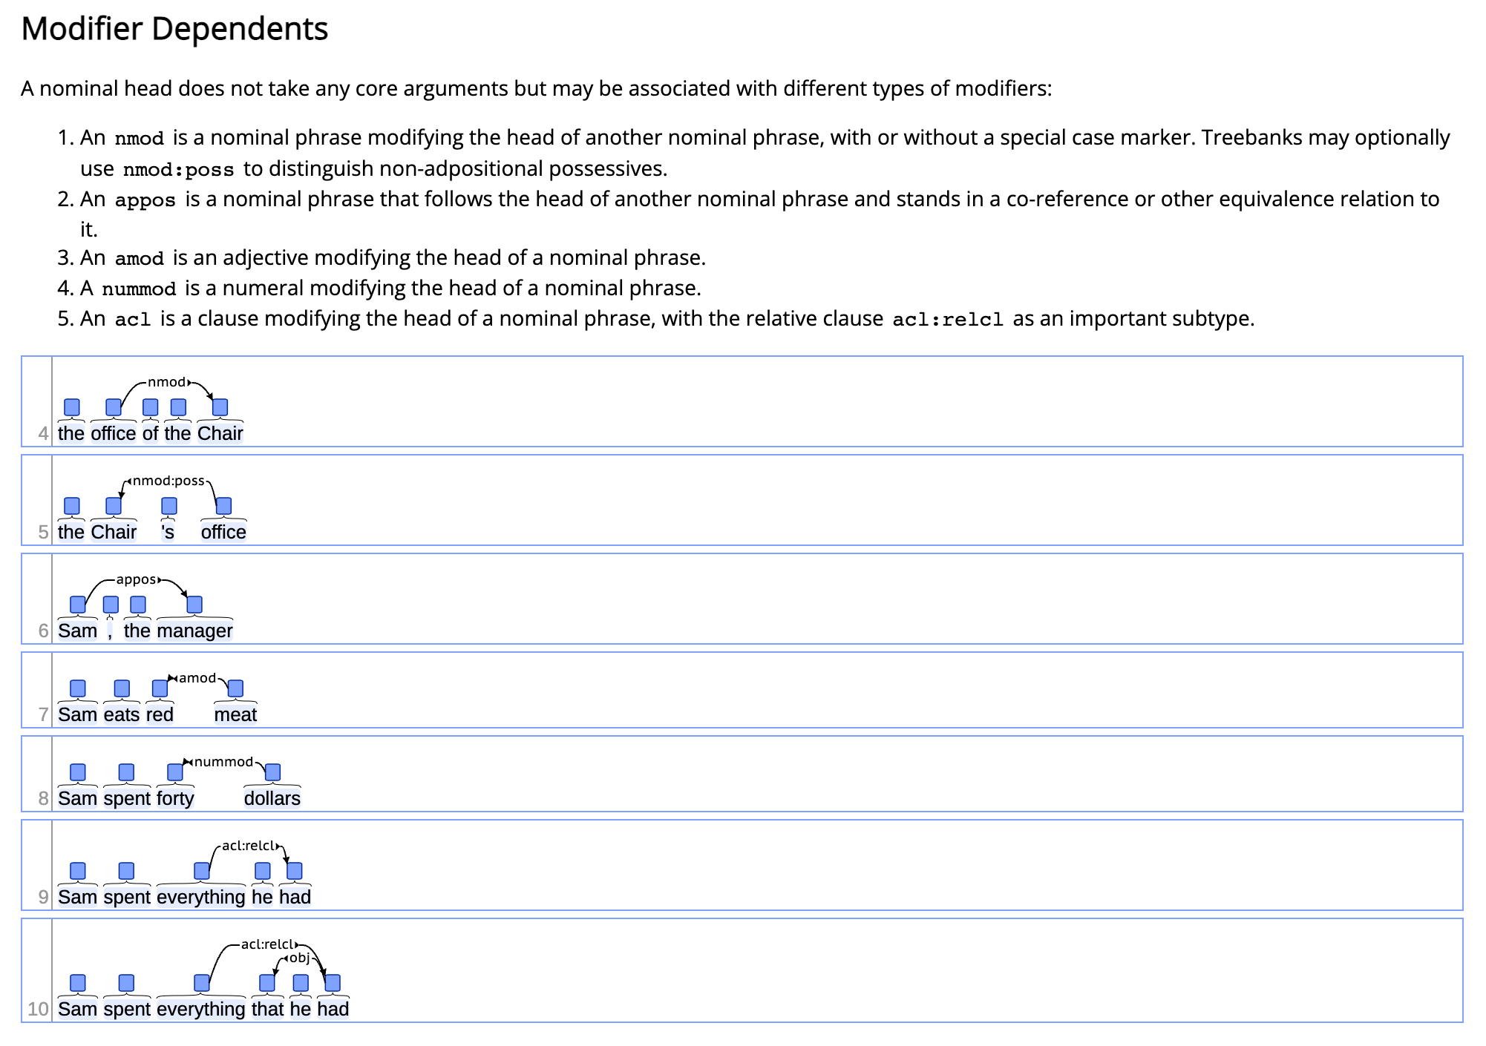
Example: Universal Dependencies
Universal Dependencies Annotation Guidelines for Nominals
A nominal minimally consists of a noun, proper noun or pronoun.
https://universaldependencies.org/#language-u

Slide 61
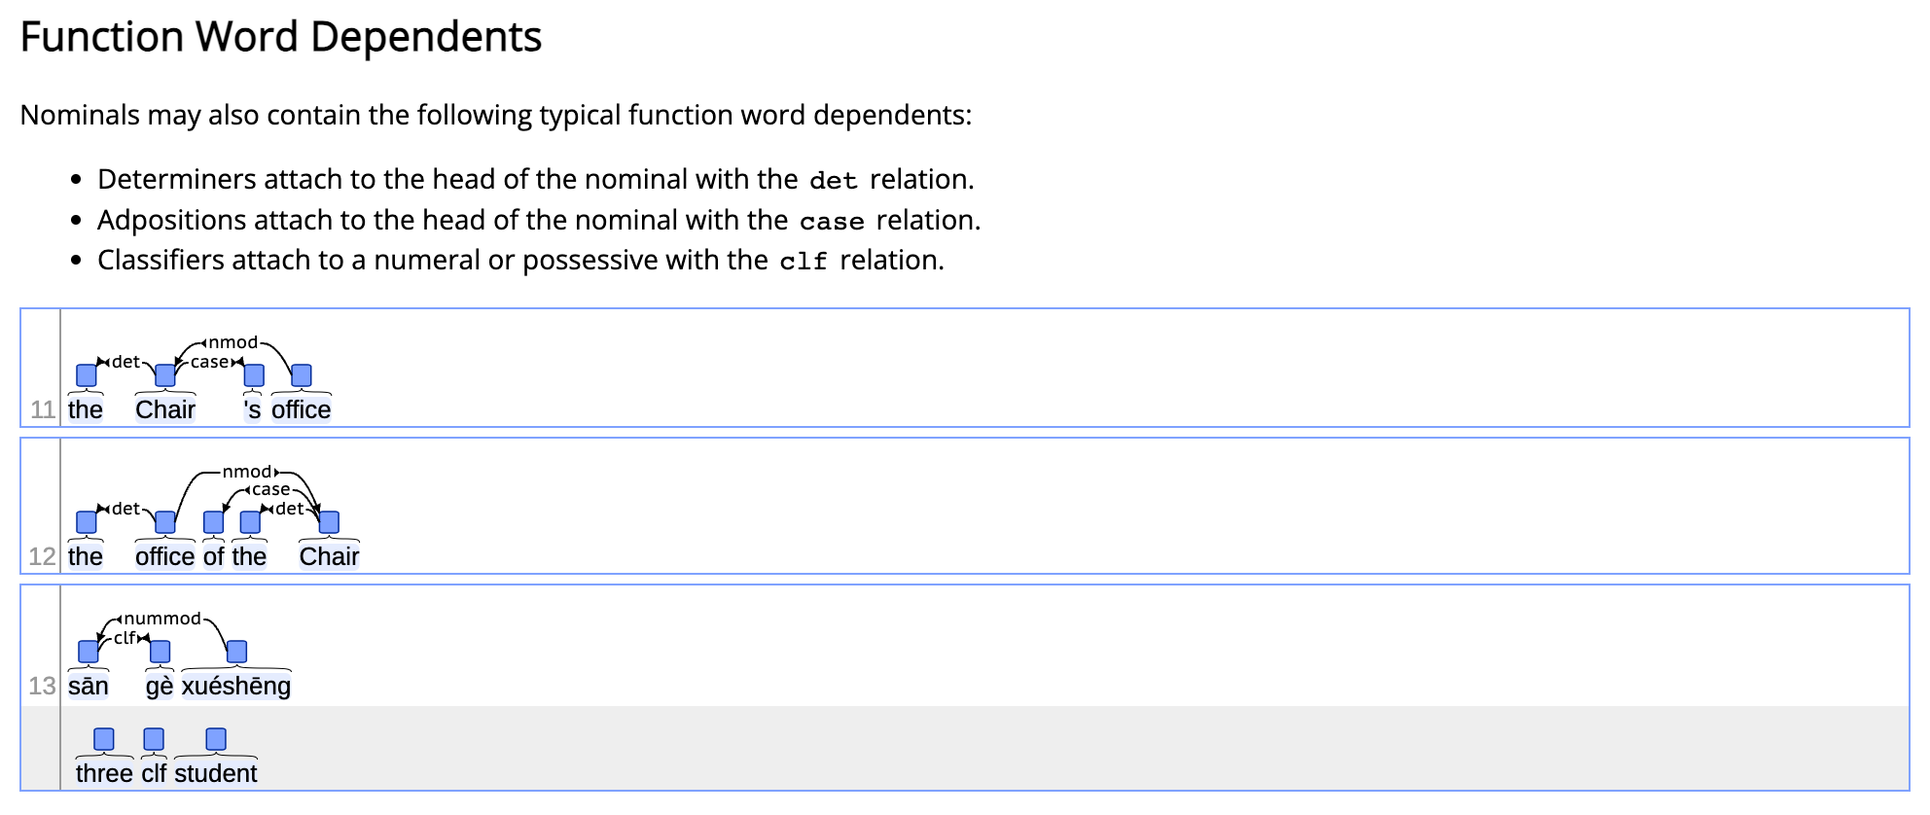
Example: Universal Dependencies
Universal Dependencies Annotation Guidelines for Nominals
A nominal minimally consists of a noun, proper noun or pronoun.
https://universaldependencies.org/#language-u

Slide 62
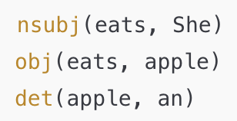
Example: Universal Dependencies
Example:
Sentence: ”She eats an apple.”
Annotation (right image)
Evaluation Metrics:
LAS (Labeled Attachment Score), UAS (Unlabeled Attachment Score)

Slide 63
Example: ACE Relation Extraction
Annotation Guidelines:
Extracts relations between named entities (e.g., Person-Organization, Parent-Child).
Relations are directional (e.g., works_for vs. employs).
Link: ACE (Automatic Content Extraction) English Annotation Guidelines for Relations
Examples:
Sentence: "Steve Jobs founded Apple."
Relation: Founder(Steve Jobs, Apple)
Sentence: "Obama was born in Hawaii."
Relation: Born-In(Obama, Hawaii)
Evaluation Metrics:
Precision, Recall, F1-score

Slide 64
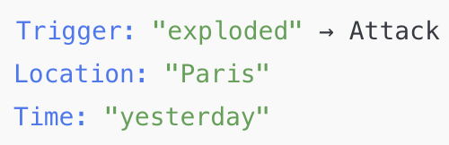
Example: ACE / MUC Event Extraction
Goal:
Identifies event triggers and their arguments.
Label Set:
Event types: Attack, Arrest, Meeting, Transfer-Money, etc.
Annotation Guideline:
Link: ACE (Automatic Content Extraction) English Annotation Guidelines for Events
Examples:
Sentence: "A bomb exploded in Paris yesterday."
Event: Attack
Argument (right image)
Evaluation Metrics:
Precision, Recall, F1-score

Slide 65
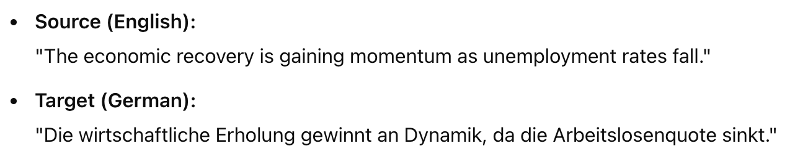
Example: WMT Machine Translation
Goal:
Advance MT Research: Promote innovation and collaboration in machine translation.
Benchmarking: Provide standardized datasets and metrics for consistent system evaluation.
Label Set:
Multidimensional Quality Metrics (MQM): Classifies errors by type (accuracy, fluency, style) and severity (minor, major, critical). Error Span Annotation (ESA): Combines Direct Assessment (DA) with targeted error marking for efficient human evaluation.
Examples:
Evaluation Metrics:
BLEU, COMET

Slide 66
Example: WMT Machine Translation
BLEU (Bilingual Evaluation Understudy)
Measures n-gram precision by checking how many n-gram sequences (e.g., unigrams, bigrams) from the machine output appear in the reference translations.
Uses a brevity penalty to avoid favoring shorter translations.
COMET (Cross-lingual Optimized Metric for Evaluation of Translation)
Uses embeddings to compare the semantic similarity between the machine translation, the reference, and the source sentence.
Trained on human evaluation data for better alignment with human judgment.

Slide 67
Example: CNN/DailyMail Summarization
Goal:
Summarization Development: Provide a large-scale dataset to train and evaluate models for both extractive and abstractive text summarization.
Label Set:
Dataset Composition: Over 300,000 English news articles from CNN and Daily Mail, each paired with human-written highlights serving as reference summaries.
Examples:
Article: "Scientists have discovered a new exoplanet orbiting a distant star...”
Summary: "New exoplanet discovered.”
Evaluation Metrics:
ROUGE-1, ROUGE-2, ROUGE-L

Slide 68
Example: CNN/DailyMail Summarization
ROUGE-1:
Measures the overlap of unigrams (single words) between the generated text and the reference.
ROUGE-2:
Measures the overlap of bigrams (two consecutive words) between the generated and reference texts.
ROUGE-L:
Measures the Longest Common Subsequence (LCS) between the generated text and the reference.

Slide 69
MNLI (Multi-Genre Natural Language Inference)
Goal:
to determine the logical relationship between a pair of sentences: a premise and a hypothesis.
Label Set:
entailment, contradiction, or neutral.
Examples:
Premise: "A man is playing a guitar.”
Hypothesis: "A musician is performing." → Entailment
Hypothesis: "A man is sleeping." → Contradiction.”
Evaluation Metrics:
Accuracy

Slide 70
Example: SQuAD (Question Answering)
Goal:
Provides a passage and asks extractive questions.
Annotation Guideline:
Answers must be direct spans from the passage.
Examples:
Passage: "Albert Einstein was born in Germany in 1879.”
Q: "Where was Einstein born?”
A: "Germany”
Evaluation Metrics:
Exact Match (EM), F1-score

Slide 71
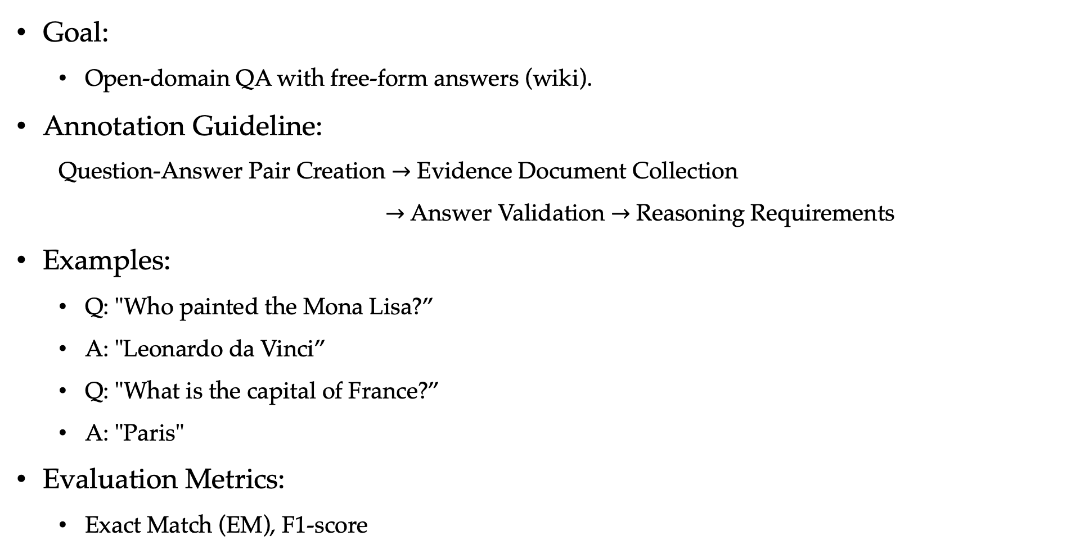
Example: TriviaQA
Goal:
Open-domain QA with free-form answers (wiki).
Annotation Guideline:
Question-Answer Pair Creation $→$ Evidence Document Collection
$→$ Answer Validation $→$ Reasoning Requirements
Examples:
Q: "Who painted the Mona Lisa?”
A: "Leonardo da Vinci”
Q: "What is the capital of France?”
A: "Paris"
Evaluation Metrics:
Exact Match (EM), F1-score

Slide 72
Outline
2.1 The modeling paradigm
2.1.1 Categorizing NLP tasks
2.1.2 The modeling paradigm
2.1.3 Training
2.1.4 Evaluation
2.2 Data
2.2.1 The Framework
2.2.2 Data Collection
2.2.3 Annotation
2.2.4 Quality Control
2.3 Probability
2.3.1 Probability distribution
2.3.2 Multiple random variables

Slide 73
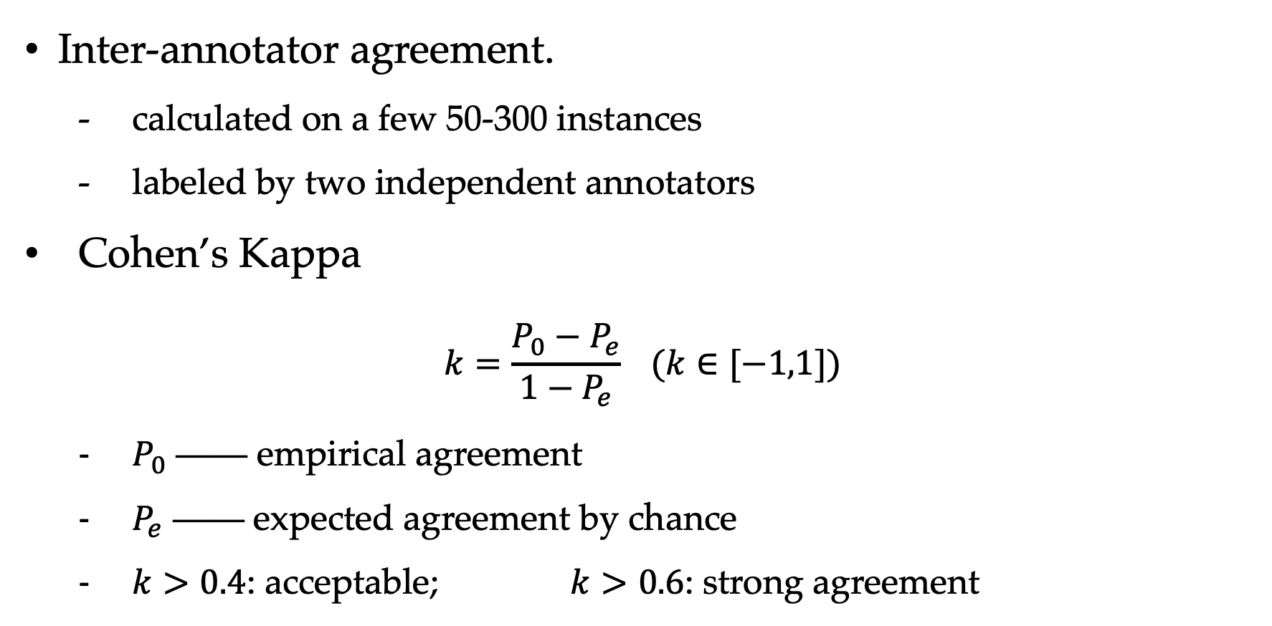
Quality Estimation
Inter-annotator agreement.
calculated on a few 50-300 instances
labeled by two independent annotators
Cohen’s Kappa
$$k=\frac{P_{0}−P_{e}}{1−P_{e}} (k∈[−1,1])$$
$P_{0}$ —— empirical agreement
$P_{e}$ —— expected agreement by chance
$k>0.4$: acceptable; $k>0.6$: strong agreement

Slide 74


Quality Estimation
Cohen’s Kappa: $k=\frac{P_{0}−P_{e}}{1−P_{e}} (k∈[−1,1])$
$P_{0}$ —— empirical agreement $P_{e}$ —— expected agreement by chance
Sentiment Classification
A: 500 positive, 400 negative, 100 neutral; B: 450 positive, 460 negative, 90 neutral
agreed: 400 positive, 380 negative, 80 neutral
$P_{0}\left(pos\right)=\frac{400}{1000}=0.4,$ $P_{0}\left(neg\right)=\frac{380}{1000}=0.38,$ $P_{0}\left(neu\right)=\frac{80}{1000}=0.08,$
$P_{e}\left(pos,A\right)=\frac{500}{1000}=0.5,$ $P_{e}\left(pos,B\right)=\frac{450}{1000}=0.45,$ ${⟹P}_{e}\left(pos\right)=0.5×0.45=0.225,$
$P_{e}\left(neg,A\right)=\frac{400}{1000}=0.4,$ $P_{e}\left(neg,B\right)=\frac{460}{1000}=0.46,$ ${⟹P}_{e}\left(neg\right)=0.4×0.46=0.184,$
$P_{e}\left(neu,A\right)=\frac{100}{1000}=0.1,$ $P_{e}\left(neu,B\right)=\frac{90}{1000}=0.09,$ ${⟹P}_{e}\left(neu\right)=0.1×0.09=0.009,$
$$k=\frac{P_{0}−P_{e}}{1−P_{e}}=\frac{0.442}{0.582}=0.76$$
$$P_{0}=P_{0}\left(pos\right)+P_{0}\left(neg\right)+P_{0}(neu)=0.86$$
$$P_{e}=P_{e}\left(pos\right)+P_{e}\left(neg\right)+P_{e}(neu)=0.418$$

Slide 75
Outline
2.1 The modeling paradigm
2.1.1 Categorizing NLP tasks
2.1.2 The modeling paradigm
2.1.3 Training
2.1.4 Evaluation
2.2 Data
2.2.1 The Framework
2.2.2 Data Collection
2.2.3 Annotation
2.2.4 Quality Control
2.3 Probability
2.3.1 Probability distribution
2.3.2 Multiple random variables

Slide 76
Outline
2.1 The modeling paradigm
2.1.1 Categorizing NLP tasks
2.1.2 The modeling paradigm
2.1.3 Training
2.1.4 Evaluation
2.2 Data
2.2.1 The Framework
2.2.2 Data Collection
2.2.3 Annotation
2.2.4 Quality Control
2.3 Probability
2.3.1 Probability distribution
2.3.2 Multiple random variables

Slide 77



Probability
Chance of random event
empirically: relative frequency
philosophically: inherent characteristics
Random events and random variables
event | outcome
coin tossing | head, tail
dice casting | 1, 2, 3, 4, 5, 6
next token prediction | $$w∈V$$
Discrete random variables
$$\sum_{r}{P(r)}=1$$
$r$ —— possible values

Slide 78
Probability Distributions
The probabilities of all possible values of a discrete random variable is a probability distribution
A Bernoulli distribution example:
coin tossing
A categorical distribution (multi-noulli distribution) example:
dice casting, word drawing
0
1
1
2
3
4
5
6

Slide 79

Probability Distributions
- A binomial distribution: the results of $n$ i.i.d. Bernoulli distributions, e.g., for coin tossing:
$P_{BIN}\left(k,n\right)=\frac{n!}{k!\left(n−k\right)!}$ ${P_{BER}\left(heads\right)}^{k}$ ${P_{BER}\left(tails\right)}^{n−k}$
- A multinomial distribution: the results of $n$ i.i.d. categorical distributions e.g., for dice casting:
$P_{MUL}\left(c1,\text{c}\text{2}\text{,}…c6,n\right)=\frac{n!}{c1! … c6!}$ ${P_{CAT}\left(1\right)}^{c1}$ $…{P_{CAT}\left(6\right)}^{c6}$

Slide 80



Probability Distributions
Continuous random variable:
Probability density function
- A uniform distribution:
$f\left(y\right)= \frac{1}{b−a} for y ε [a,b]$
- A Gaussian normal distribution:
$f\left(y\right)= \frac{1}{\sqrt{2π}σ} exp⁡(−\frac{{(y−μ)}^{2}}{2σ^{2}})$

Slide 81



Probability Distributions
Vector random variable:
- A uniform distribution:
$f\left(x_{1},x_{2}, …,x_{n}\right)=$
$\frac{1}{\prod_{i}^{n}{(H_{i}−L_{i})}}$ , $for L_{i}≤x_{i}≤H_{I}, 1≤i≤n$
- A Gaussian normal distribution:
$f\left(x_{1},x_{2}, …,x_{n}\right)=$
$\frac{1}{{(2π)}^{n/2}{|Σ|}^{1/2}} exp⁡(−\frac{1}{2}{(\vec{X}−\vec{μ})}^{T}Σ^{−1}(\vec{X}−\vec{μ}))$

Slide 82
Outline
2.1 The modeling paradigm
2.1.1 Categorizing NLP tasks
2.1.2 The modeling paradigm
2.1.3 Training
2.1.4 Evaluation
2.2 Data
2.2.1 The Framework
2.2.2 Data Collection
2.2.3 Annotation
2.2.4 Quality Control
2.3 Probability
2.3.1 Probability distribution
2.3.2 Multiple random variables

Slide 83

Multiple Random Variables
joint events
coin = head, dice = 5
In a sentence,
$w_{1}=“Hello”, w_{2}=“,”, w_{3}=“world”$
In a POS sequence,
$p_{1}=NNS, p_{2}=VB, p_{3}=ADJ, p_{4}=NN$

Slide 84





Multiple Random Variables
joint events
$A:$ $coin=head$ $¬A:$ $coin=tail$
$B:$ $dice=5$ $¬B:$ $dice=1, 2, 3, 4, 6$
$$A∩B ( ): coin=head \& dice=5$$
A
B
$$P\left(A\right)=$$
$$P\left(B\right)=$$
$$P\left(A,B\right)=$$

Slide 85

Multiple Random Variables
conditional probability
$P\left(dice=5 \right| coin=head)$
In a sentence, $P\left(w_{2} \right|w_{1}=“Hello”)$
In a POS sequence, $P\left(p_{3}=ADJ \right| p_{1}=NNS,p_{2}=VB,p_{4}=NN)$

Slide 86






Multiple Random Variables
conditional probability
$P\left(dice=5 \right| coin=head)$
In a sentence, $P\left(w_{2} \right|w_{1}=“Hello”)$
In a POS sequence, $P\left(p_{3}=ADJ \right| p_{1}=NNS,p_{2}=VB,p_{4}=NN)$
A
B
$$P\left(A\right)=$$
$$P\left(B\right)=$$
$$=\frac{P(AB)}{P(B)}$$
$$=\frac{P(AB)}{P(A)}$$
$$P\left(A|B\right)=$$
$$P\left(B|A\right)=$$
B
A

Slide 87




Multiple Random Variables
conditional probability
$P\left(dice=5 \right| coin=head)$
In a sentence, $P\left(w_{2} \right|w_{1}=“Hello”)$
In a POS sequence, $P\left(p_{3}=ADJ \right| p_{1}=NNS,p_{2}=VB,p_{4}=NN)$
conditional independence
$$P(A|B)=P(A)$$
$$∴ \frac{P(AB)}{P(B)}=P(A)$$
$∴ P(AB)=P(A)$ $∙P(B)$
$$∴ P(B|A)=P(B)$$

Slide 88




Multiple Random Variables
Bayes rule
$$P(A|B)=\frac{P(B|A)∙P(A)}{P(B)}$$
$$P(B|A)=\frac{P(A|B)∙P(B)}{P(A)}$$
Proof
$$P\left(A | B\right)=\frac{P\left(AB\right)}{P\left(B\right)}⇒P\left(A | B\right)∙P\left(B\right)=P(AB)$$
$$P\left(B | A\right)=\frac{P\left(AB\right)}{P\left(A\right)}⇒P\left(B | A\right)∙P\left(A\right)=P(AB)$$
$$∴ P\left(A | B\right)∙P\left(B\right)=P\left(B | A\right)∙P\left(A\right)$$

Slide 89



Multiple Random Variables
Marginal probability —— probability of some random variable(s) in a joint event.
e.g.,
joint | marginal
$$P(A,B)$$ | $$P(A)$$
$$P\left(A,B,C\right)$$ | $$P(A)$$
$$P\left(A,B,C\right)$$ | $$P(A,B)$$
Marginalization
$$P\left(A\right)=\sum_{b∈B}{P(A,b)}$$
$$P\left(A\right)=\sum_{b∈B,c∈C}{P(A,b,c)}$$

Slide 90




Multiple Random Variables
Marginal probability —— probability of some random variable(s) in a joint event.
$$coin=head, tail$$
$$dice=1, 2, 3, 4, 5, 6$$
1000 joint experiments
 | 1 | 2 | 3 | 4 | 5 | 6
head | 80 | 55 | 90 | 60 | 95 | 50
tail | 70 | 65 | 100 | 85 | 125 | 125
$$P\left(head,2\right)=55$$
$$P\left(head\right)=\sum_{i=1}^{6}{P\left(head,i\right)=\frac{80+55+90+60+95+50}{1000}=0.43}$$
$$P\left(4\right)=\frac{60+85}{1000}=0.145$$

Slide 91
Summary
In this week, we have learned:
Data and Model
NLP Task Types
Training and Evaluation
Data Curation
Probability Review

